Slide 1
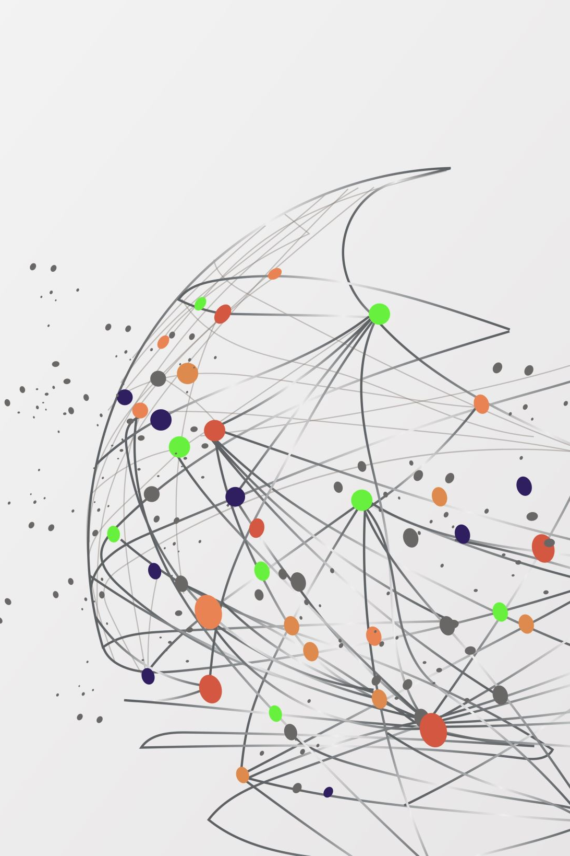

SIT305 – HD Demonstration
App Name: ConnectSphere AI
Student Name: Hayden Duong
Student ID: s222610226

Slide 2

Concept Connecting like-minded individuals and form communities.
Objectives
Provide natural AI chat experience, Llama 2.
Identify user interests through conversation.
Personalize users & groups recommendation.

Slide 3
Mechanism

Slide 4
Tech Stack
Frontend: Android (Java).
Backend: Python with Flask.
AI Model: Llama-2-7b-chat-hf.
Database: Neo4j (Graph)
Authentication: Firebase.

Slide 5
Development Process
Methodology:
Iterative development approach.
Key Stages
AI & authentication integration.
Interest extraction & database storing.
Recommendation feature.
Personal & Group chat.

Slide 6
Challenges
Llama2’s Output.
Social Graph in Neo4j (Cypher queries).
User Id Displayment.

Slide 7

Live Demonstration

Slide 8
Future Work
AI model.
Real-time Features.
Richer profile customization.
Expanding group functionalities.
Personalize Ads.

